Slide 1
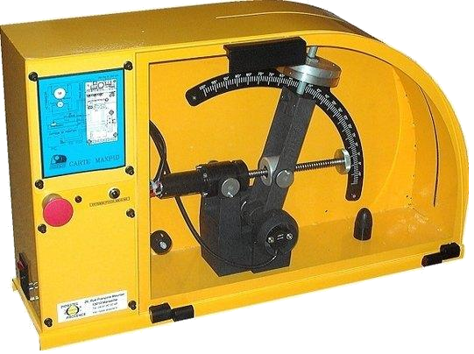
Dossier ressources
ILOT MAXPID

Slide 2
ILOT MAXPID

